Slide 1
Entity Relationship Model ( ER – Model)

Slide 2

Looping
Outline
Basic concept of E-R diagram
Types of Attributes
Mapping Cardinality
Weak Entity Sets
Extended E-R features
Generalization and Specialization
Constraints on Specialization and Generalization
Aggregation
E-R diagram of Hospital Management System
Reduction to E-R Database Schema
Database Models
Integrity Constraints

Slide 3

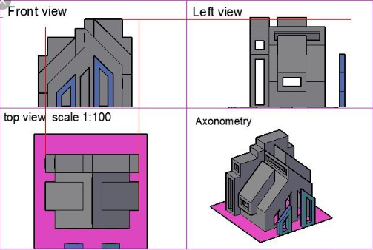
Design phase
we use diagram to explain what are the things in your database
High Level view
ER Model
Representational view
Use relations(table)
Relational
Model
Construction where the individual items going to fit(Implementation)
How we are going to store the table in HDD what structure is required, how much byte is required, how much byte is skipped for accessing records
Low Level view

Slide 4
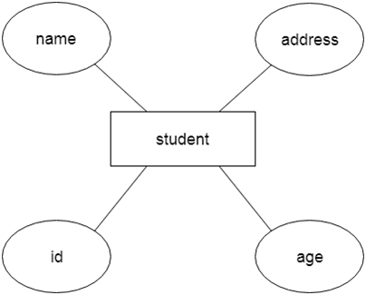
Basic concepts
What is Database Design?
Database Design is a collection of processes that facilitate the designing, development, implementation and maintenance of enterprise database management systems.
What is E-R diagram?
E-R diagram: (Entity-Relationship diagram)
It is a high-level data model or conceptual model that gives the graphical (pictorial) representation of the logical structure of the database.
It shows all the constraints and relationships that exist among the different components.
It uses different types of symbols to represent different objects of database.
For example, Suppose we design a school database. In this database, the student will be an entity with attributes like address, name, id, age, etc. The address can be another entity with attributes like city, street name, pin code, etc and there will be a relationship between them.

Slide 5
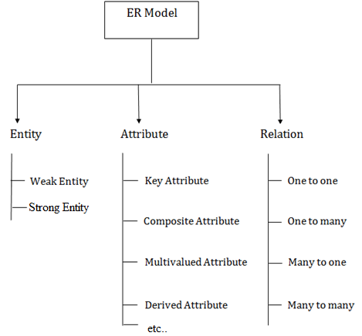
Components of ER diagram
An ER diagram is mainly composed of following three components-
Entity
Attributes
Relationship

Slide 6
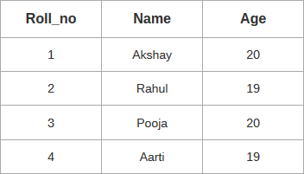
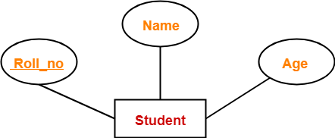
Consider the following Student table-
This complete table is referred to as “Student Entity Set” and each row represents an “entity”. | Here, Roll_no is a primary key that can identify each entity uniquely. Thus, by using student’s roll number, a student can be identified uniquely.

Slide 7
Project
Collect the information(verbal description from client)→diagram
Noun → Entity{ a person owns a car : person}
Verb → relationship{ a employee works for department}, any verb going to describe is relationship
Noun describes noun → attribute {property of the entity}
Employee works for Department: Person, employee, Department ← (thing) →Entity Name, age, address phone ← (properties) →Attribute Works_for, owns {verbs} ←(association) → Relationship

Slide 8
1(a). Entity
An entity is a person, a place or an object.
An entity is represented by a rectangle which contains the name of an entity.
Entities of a college database are:
Student
Professor/Faculty
Course
Department
Result
Class
Subject
Entity Name
Symbol
Student
Faculty
Course
Exercise
Write down the different entities of bank database.
Exercise
Write down the different entities of hospital database.

Slide 9



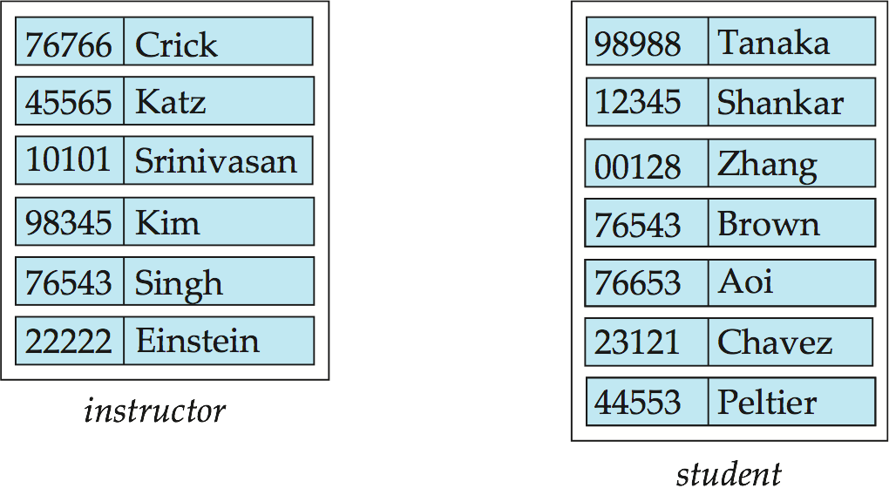
1(b) Entity Set
It is a set (group) of entities of same type.
Examples:
All persons having an account in a bank
All the students studying in a college
All the professors working in a college
Set of all accounts in a bank

Slide 10
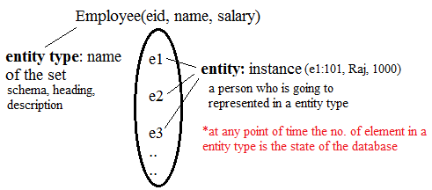
Example
An entity is an object that exists and is distinguishable from other objects.
Example: specific person, company, event, plant
An entity type or set is a set of entities of the same type that share the same properties.
Example: set of all persons, companies, trees, holidays

Slide 11

2. Attributes
Attribute is properties or details about an entity.
An attribute is represented by an oval containing name of an attribute.
Attributes of Student are:
Roll No
Student Name
Branch
Semester
Address
Mobile No
Age
SPI
Backlogs
Attribute Name
Symbol
RollNo
Name
Student
Exercise
Write down the different attributes of Faculty entity.
Exercise
Write down the different attributes of Account entity.

Slide 12
3. Relationship
Relationship is an association (connection) between several entities.
It should be placed between two entities and a line connecting it to an entity.
A relationship is represented by a diamond containing relationship's name.
Relationship Name
Symbol
Employee
Works_for
Department

Slide 13
E-R Diagram of a Library System
Primary Key
Primary Key
Attributes
RollNo
Name
Relationship
BookNo
Name
Student
Issue
Book
Branch
Sem
Entities
Author
Price
Each and every entity must have one primary key attribute.
Relationship between 2 entities is called binary relationship.

Slide 14
Ternary Relationship
ProjectID
Project Name
Project
FacID
Name
RollNo
Name
Faculty
Guide
Student
Branch
Technology
Branch
Sem
Relationship between 3 entities is called ternary relationship.

Slide 15
Exercise
Draw an E-R diagram of following pair of entities
Customer & Account
Customer & Loan
Doctor & Patient
Student & Project
Student & Teacher
Note: Take four attributes per entity with one primary key attribute.
Keep proper relationship between two entities.

Slide 16
Types of Attributes
Simple Attribute | Composite Attribute
Cannot be divided into subparts | Can be divided into subparts
E.g. RollNo, CPI | E.g. Name (first name, middle name, last name) Address (street, road, city)
Symbol | Symbol
Name
Roll No
First name
Last name
Middle name

Slide 17
Types of Attributes
Derived Attribute | Multi-valued Attribute
It’s value is derived or calculated from other attributes | Has multiple (more than one) value
E.g. Age (can be calculated using current date and birthdate) | E.g. PhoneNo (person may have multiple phone nos) EmailID (person may have multiple emails)
Symbol | Symbol
Age
Phone No

Slide 18
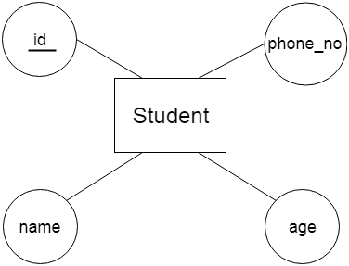
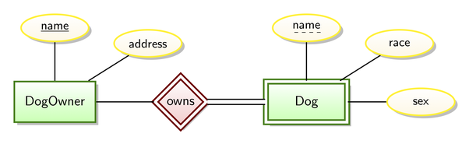
Types of Attributes
Key Attribute | Partial Attribute or partial key
The key attribute is used to represent the main characteristics of an entity. It represents a primary key. The key attribute is represented by an ellipse with the text underlined. e.g. id | It’s one or more attributes that uniquely identify a weak entity for a given owner entity.

Slide 19
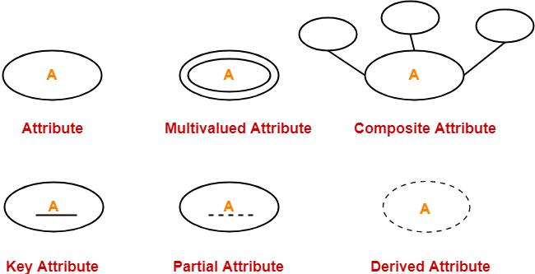
Summary

Slide 20
Entity with all types of Attributes
Middle Name
First Name
Last Name
Key attribute
RollNo
Name
Composite
Apartment
Derived
Composite
Student
Street
Age
Address
Multiple Value
Phone No
Birth Date
Area
Single Value
Simple

Slide 21
Descriptive Attribute
Attributes of the relationship is called descriptive attribute.
Descriptive Attribute
Issue Date
RollNo
Name
BookNo
Name
Student
Issue
Book
Branch
Sem
Author
Price

Slide 22
Role
Roles are indicated by labeling the lines that connect diamonds (relationship) to rectangles (entity).
The labels “Coordinator” and “Head” are called roles; they specify Faculty entities interact with whom via Reports_To relationship set.
Role labels are optional, and are used to clarify semantics (meaning) of the relationship.
EmpID
Name
Faculty
Coordinator
Reports_To
Head
Branch
Experience

Slide 23
Mapping Cardinality (Cardinality Constraints)
It represents the number of entities of another entity set which are connected to an entity using a relationship set.
It is most useful in describing binary relationship sets.
For a binary relationship set the mapping cardinality must be one of the following types:
One to Many
Many to One
Many to Many

Slide 24
a) One to Many(1:N)
Verbal Description: Every Employee works for exactly one department, and a department can have many employee, new department need not have a employee. (RA phase)
Employee
Works_for
Department
e1
e2
e3
e4
e5
e6
d1
d2
d3
Degree: 2
Max card: e(1), d(N)
Min card: e(1) ,d(0)
Every relation in relation set is actually an association between employee set and department set
cardinality: (1) (N)
participation:(1) (0)
Degree: In relationship how many entity set are participating
Cardinality ratio(max card): Maximum no of relationship a entity can participate
Participation(min card): Minimum no of relationship in each an entity can participate
*Every relationship in a relationship set is an association between employee and department
*we have to make ER diagram as readable as possible
*we can also take department first: a department employs an employee

Slide 25
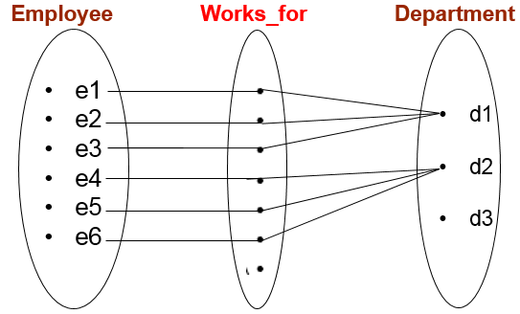
Verbal Description: Every Employee works for exactly one department, and a department can have many employee, new department need not have a employee. (RA phase)
Participation
Total participation using double line(min. card=1)
partial participation using single line(min. card=0)
Works_for
N 1
Department
Employee
Cardinality ratio/single line-double line
Cardinality 1 N

Slide 26
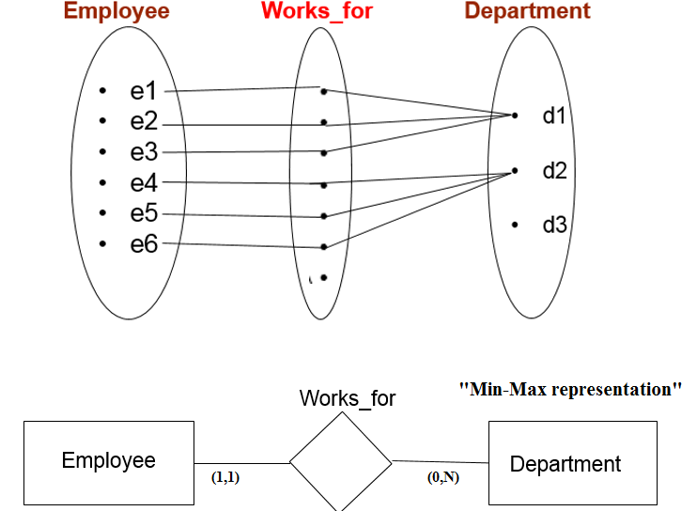
Min Max Representation
What if ? (2,N) (0,N)

Slide 27
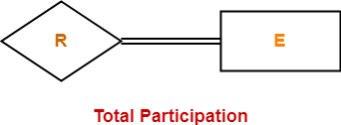

Participation
Total Participation- :
It specifies that each entity in the entity set must compulsorily participate in at least one relationship instance in that relationship set.
That is why, it is also called as mandatory participation.
Total participation is represented using a double line between the entity set and relationship set.
Here,
Double line between the entity set “Student” and relationship set “Enrolled in” signifies total participation.
It specifies that each student must be enrolled in at least one course.

Slide 28

Participation
2. Partial Participation-
It specifies that each entity in the entity set may or may not participate in the relationship instance in that relationship set.
That is why, it is also called as optional participation.
Partial participation is represented using a single line between the entity set and relationship set.
Here,
Single line between the entity set “Course” and relationship set “Enrolled in” signifies partial participation.
It specifies that there might exist some courses for which no enrolment's are made.
Minimum cardinality tells whether the participation is partial or total.
If minimum cardinality = 0, then it signifies partial participation.
If minimum cardinality = 1, then it signifies total participation.
Maximum cardinality tells the maximum number of entities that participates in a relationship set.

Slide 29
One to One(1:1)
RA: Every department should have a manager and only one employee manages department and an employee manages only one department.
Employee
Manages
Department
e1
e2
e3
e4
e5
e6
d1
d2
d3
.
.
.
Cardinality: 1 1
Participation: 0 1
manages
Department
Total participation: double line
Partial participation: single line
Employee
1 1

Slide 30
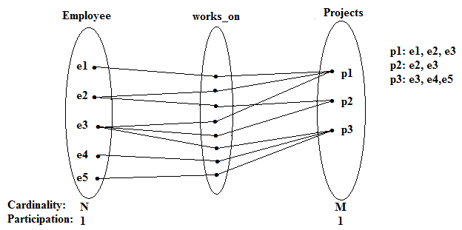
Many to many(M:N)
RA: Every employee supposed to work on atleast one project(he can work on many projects) As well as every project supposed to have many employees and it is supposed to have atleast one employee.
Works_on
Project
Employee
M N

Slide 31
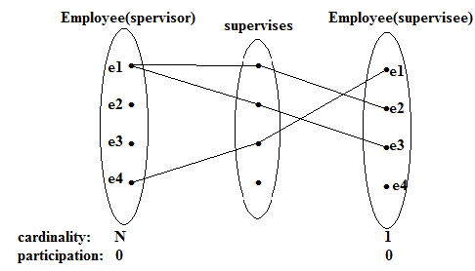
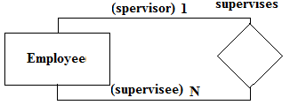
Recursive relationship
RA : Every employee suppose to report only one employee(boss or supervisor), an employee
can supervise one or more employee. It is not necessary that every employee has to manage
someone.
Degree=2

Slide 32
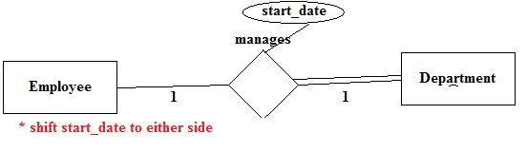
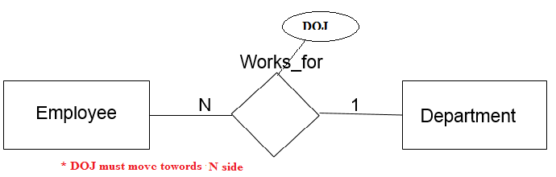
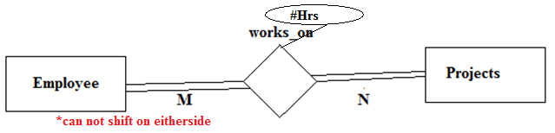
Attribute to relation
* It depends on the designer whether to shift the attribute or keep it separate relation

Slide 33
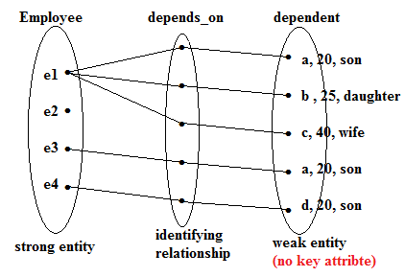

Weak Entity
On the basis of requirement analysis we identified the key attribute, some times we might not have a key attribute at all.
Example: Every dependent is associated with one employee, but some employee may not have any dependent.
Weak entity is always in total Participation with strong entity
Without strong entity weak entity does not exist
We can identity the weak entity distinctly by taking the key attribute from strong entity

Slide 34
An entity set that does not have a primary key is called weak entity set.
Payment-date
loan-no
amount
payment-no
Payment-amount
loan
L_P
payment
Strong Entity Set
Weak Entity Relationship
Weak Entity Set
Weak entity set is indicated by double rectangle.
Weak entity relationship set is indicated by double diamond.

Slide 35
The existence of a weak entity set depends on the existence of a strong entity set.
The discriminator (partial key) of a weak entity set is the set of attributes that distinguishes all the entities of a weak entity set.
The primary key of a weak entity set is created by combining the primary key of the strong entity set on which the weak entity set is existence dependent and the weak entity set’s discriminator.
We underline the discriminator attribute of a weak entity set with a dashed line.
Payment entity has payment-no which is discriminator.
Loan entity has loan-no as primary key.
So primary key for payment is (loan-no, payment-no).

Slide 36
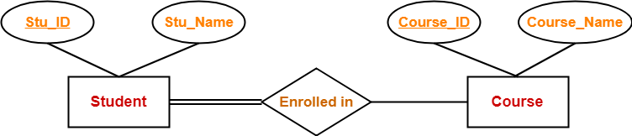
Example
In this ER diagram,
Two strong entity sets “Student” and “Course” are related to each other.
Student ID and Student name are the attributes of entity set “Student”.
Student ID is the primary key using which any student can be identified uniquely.
Course ID and Course name are the attributes of entity set “Course”.
Course ID is the primary key using which any course can be identified uniquely.
Double line between Student and relationship set signifies total participation.
It suggests that each student must be enrolled in at least one course.
Single line between Course and relationship set signifies partial participation.
It suggests that there might exist some courses for which no enrollments are made.

Slide 37
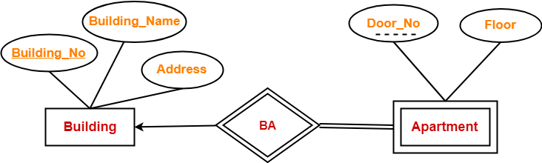
In this ER diagram,
One strong entity set “Building” and one weak entity set “Apartment” are related to each other.
Strong entity set “Building” has building number as its primary key.
Door number is the discriminator of the weak entity set “Apartment”.
This is because door number alone can not identify an apartment uniquely as there may be several other buildings having the same door number.
Double line between Apartment and relationship set signifies total participation.
It suggests that each apartment must be present in at least one building.
Single line between Building and relationship set signifies partial participation.
It suggests that there might exist some buildings which has no apartment.
To uniquely identify any apartment,
First, building number is required to identify the particular building.
Secondly, door number of the apartment is required to uniquely identify the apartment.
Primary key of Apartment = Primary key of Building + Its own discriminator
= Building number + Door number

Slide 38
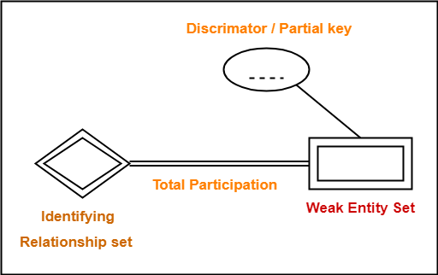
Important point
In ER diagram, weak entity set is always present in total participation with the identifying relationship set.

Slide 39
Strong vs Weak Entity
Strong entity set | Weak entity set
A single rectangle is used for the representation of a strong entity set. | A double rectangle is used for the representation of a weak entity set.
It contains sufficient attributes to form its primary key. | It does not contain sufficient attributes to form its primary key.
A diamond symbol is used for the representation of the relationship that exists between the two strong entity sets. | A double diamond symbol is used for the representation of the identifying relationship that exists between the strong and weak entity set.
A single line is used for the representation of the connection between the strong entity set and the relationship. | A double line is used for the representation of the connection between the weak entity set and the relationship set.
Total participation may or may not exist in the relationship. | Total participation always exists in the identifying relationship.

Slide 40
Exercise 1
Draw an ER diagram for Sony Music Company, which store information about musicians who perform on its albums (as well as other company data) in a database.
Each musician that records at SonyMusic has an SSN, a name, an address, and a phone number.
Each instrument used in songs recorded at SonyMusic has a unique identification number, a name (e.g., guitar, synthesizer, flute) and a musical key (e.g., C, B-flat, E-flat).
Each album recorded on the SonyMusic label has a unique album identifier, a title, a copyright date, a format (e.g., CD or MC).
Each song recorded at SonyMusic has a title and an author.
Each musician may play several instruments, and a given instrument may be played by several musicians.
Each album has a number of songs on it, but no song may appear on more than one album.
Each song is performed by one or more musicians, and a musician may perform a number of songs.
Each album has exactly one musician who acts as its producer. A musician may produce several albums, of course.

Slide 41
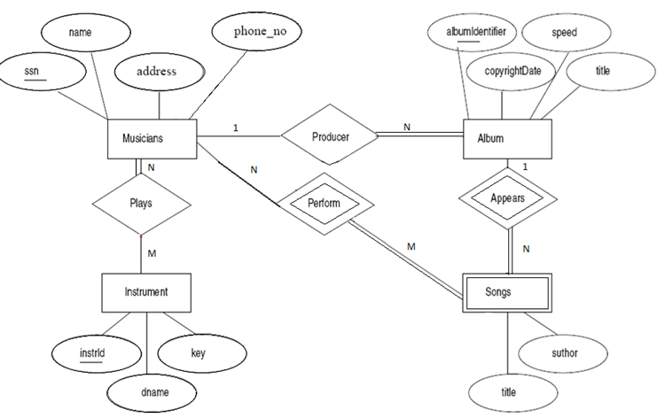
Solution

Slide 42
Exercise 2
Draw an ER diagram for the given scenario;
Suppose that you are designing a schema to record information about reality shows on TV. Your database needs to record the following information:
For each reality show, its name, genre, basic-info and participants name. Any reality show has at least two or more participants.
For each producer, the company name, company country. A show is produced by exactly one producer. And one producer produces exactly one show.
For each television, its name, start year, head office. A television may broadcasts multiple shows. Each show is broadcasted by exactly one television.
For each user, his/her username, password, and age. A user may rate multiple shows, and a show may be rated by multiple users. Each rating has a score of 0 to 10.
Draw an entity relationship diagram for this database.

Slide 43
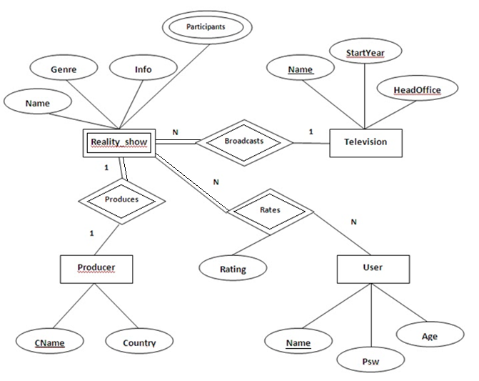
Solution

Slide 44
Exercise 3
Consider the following requirements list:
The university offers one or more programs.
A program is made up of one or more courses.
A student must enroll in a program.
A student takes the courses that are part of her program.
A program has a name, a program identifier, the total credit points required to graduate, and the year it commenced.
A course has a name, a course identifier, a credit point value, and the year it commenced.
Students have one or more given names, a surname, a student identifier, a date of birth, and the year they first enrolled. We can treat all given names as a single object—for example, “John Paul.”
When a student takes a course, the year and semester he attempted it are recorded. When he finishes the course, a grade (such as A or B) and a mark (such as 60 percent) are recorded.
Each course in a program is sequenced into a year (for example, year 1) and a semester (for example, semester 1).

Slide 45
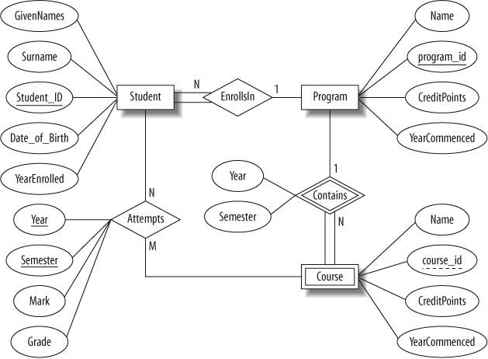
Solution

Slide 46
Exercise 4
Consider the following requirements list:
The airline has one or more airplanes.
An airplane has a model number, a unique registration number, and the capacity to take one or more passengers.
An airplane flight has a unique flight number, a departure airport, a destination airport, a departure date and time, and an arrival date and time.
Each flight is carried out by a single airplane.
A passenger has given names, a surname, and a unique email address.
A passenger can book a seat on a flight.

Slide 47
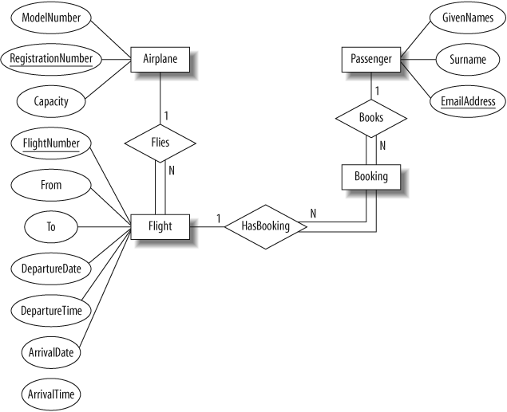
Solution

Slide 48
Exercise 5
Suppose you are given the following requirements for a simple database for the National Hockey League (NHL):
the NHL has many teams.
each team has a name, a city, a coach, a captain, and a set of players.
each player belongs to only one team.
each player has a name, a position (such as left wing or goalie), a skill level, and a set of injury records.
a team captain is also a player.
a game is played between two teams (referred to as host_team and guest_team) and has a date (such as May 11th, 1999) and a score (such as 4 to 2).
Construct a clean and concise ER diagram for the NHL database.

Slide 49
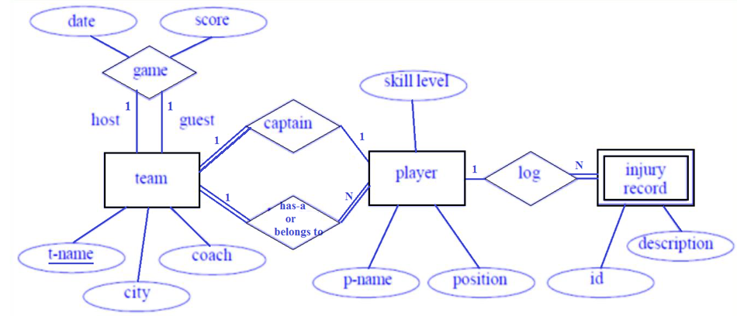
Solution

Slide 50
Exercise 6
Consider a car-insurance company:
Each customer or person have their name, address and unique driver id.
Each car is having model, year and licence no.
While each accident which is reported in terms of location, date and report no.
Each customers own one or more cars.
Each car has associated with it zero to any number of recorded accidents.

Slide 51
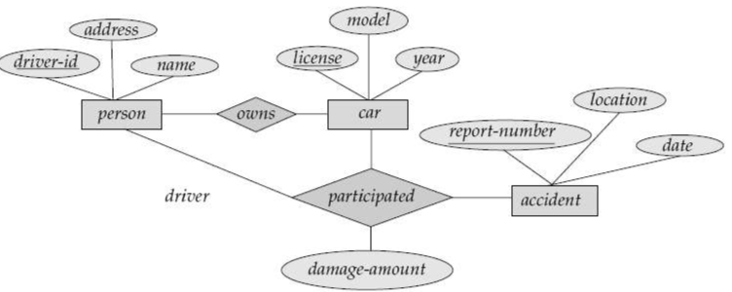
Solution

Slide 52
E-R diagram of Hospital Management System
MRID
PatID
Name
HosID
Name
Medical Record
Has
Patient
Admitted
Hospital
Report Name
ISA
Has
Treats
Indoor
Outdoor
Doctor
RoomNo
IPDID
OPDID
DrID
Dr Name
Charge

Slide 53
Generalization v/s Specialization
Generalization | Specialization
It extracts the common features of multiple entities to form a new entity. | It splits an entity to form multiple new entities that inherit some feature of the splitting entity.
Name
Address
Name
Address
SPI
Salary
Person
Person
Name
Name
ISA
ISA
Bottom-up approach
Top-down approach
Address
Address
Student
Faculty
Student
Faculty
SPI
Salary
SPI
Salary

Slide 54
Generalization v/s Specialization
Generalization | Specialization
The process of creation of group from various entities is called generalization. | The process of creation of sub-groups within an entity is called specialization.
It is Bottom-up approach. | It is Top-down approach.
The process of taking the union of two or more lower level entity sets to produce a higher level entity set. | The process of taking a sub set of higher level entity set to form a lower level entity set.
It starts from the number of entity sets and creates high level entity set using some common features. | It starts from a single entity set and creates different low level entity sets using some different features.

Slide 55
Generalization & Specialization example
Name
Address
PID
City
Person
ISA
Salary
Employee
Customer
Balance
ISA
Full Time
Part Time
Days Worked
Hour Worked

Slide 56
Aggregation
Aggregation is a process in which a single entity alone is not able to make sense in a relationship so the relationship of two entities acts as one entity.
Company
Customer
Employee
Works
Department
Customer
Can not connect two relationship
Borrow
Borrow
Loan
Loan
Process of creating an entity by combining various components of E-R diagram is called aggregation.

Slide 57
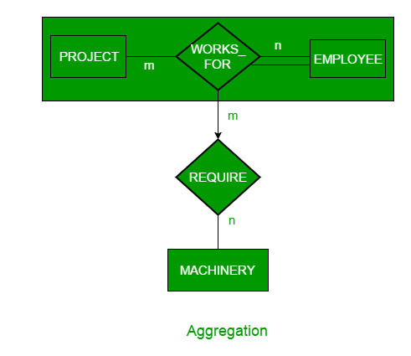
Employee working for a project may require some machinery. So, REQUIRE relationship is needed between relationship WORKS_FOR and entity MACHINERY. Using aggregation, WORKS_FOR relationship with its entities EMPLOYEE and PROJECT is aggregated into single entity and relationship REQUIRE is created between aggregated entity and MACHINERY.

Slide 58
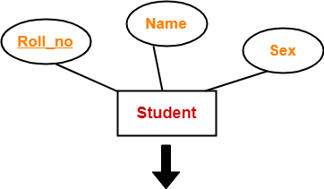
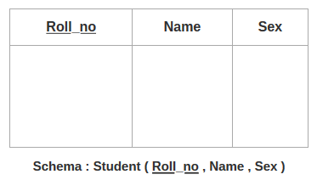
Conversion of ER model to Relational model
Rule-01: For Strong Entity Set With Only Simple Attributes-
A strong entity set with only simple attributes will require only one table in relational model.
Attributes of the table will be the attributes of the entity set.
The primary key of the table will be the key attribute of the entity set.

Slide 59
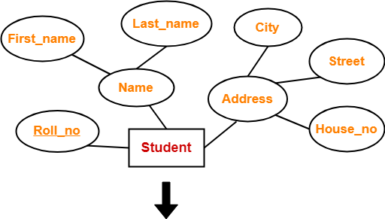
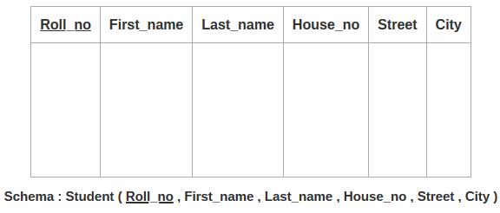
Rule-02: For Strong Entity Set With Composite Attributes-
A strong entity set with any number of composite attributes will require only one table in relational model.
We will create column for components of composite attribute only.

Slide 60
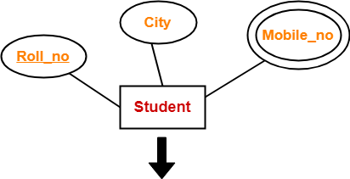
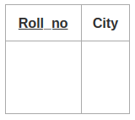
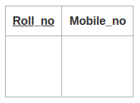
Rule-03: For Strong Entity Set With Multi Valued Attributes-
A strong entity set with any number of multi valued attributes will require two tables in relational model.
One table will contain all the simple attributes with the primary key.
Other table will contain the primary key and all the multi valued attributes.

Slide 61
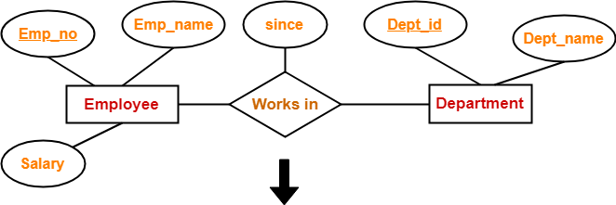
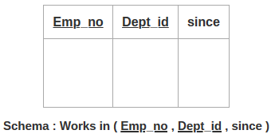
Rule-04: Translating Relationship Set into a Table-
A relationship set will require one table in the relational model.
Attributes of the table are-
Primary key attributes of the participating entity sets
Its own descriptive attributes if any.
Set of non-descriptive attributes will be the primary key.
It is not mandatory to create table for relationship, but in case of M:N relationship we must need a separate table for relationship
If we consider the overall ER diagram, three tables will be required in relational model-
One table for the entity set “Employee”
One table for the entity set “Department”
One table for the relationship set “Works in”

Slide 62
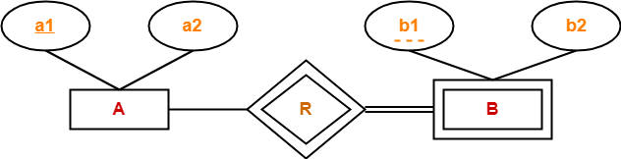
Rule-04.5: For Weak Entity Set :-
Weak entity are converted into tables of their own with primary key of strong entity acting as foreign key in the table.
Composite prime attribute of the table= FK + attribute of WE
Weak entity set always appears in association with identifying relationship with total participation constraint.
Here, two tables will be required-
A ( a1 , a2 )
B ( a1 , b1 , b2 )
Composite key attribute(primary key)=(a1+b1)

Slide 63
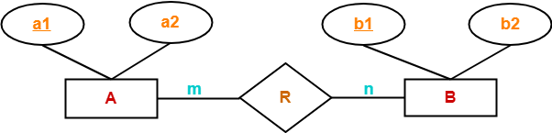
Rule-05: For Binary Relationships With Cardinality Ratios-
The following four cases are possible-
Case-01: Binary relationship with cardinality ratio m:n
Case-02: Binary relationship with cardinality ratio 1:n
Case-03: Binary relationship with cardinality ratio m:1
Case-04: Binary relationship with cardinality ratio 1:1
Case-01: For Binary Relationship With Cardinality Ratio m:n
Emp
Project
Here, three tables will be required-
A ( a1 , a2 )
R ( a1 , b1 )
B ( b1 , b2 )
If relationship attribute(start_date)
Will be in the relationship table

Slide 64
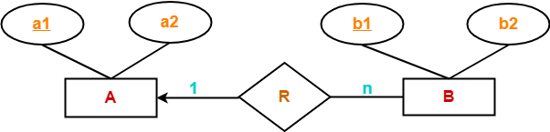
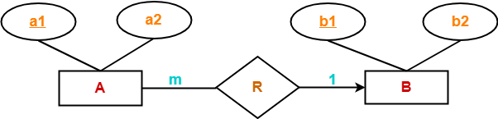
Case-02: For Binary Relationship With Cardinality Ratio 1:n
Here, two tables will be required-
A ( a1 , a2 )
BR ( a1 , b1 , b2 )
teacher
subject
If relationship attribute(start_date)
Shift towards N side
Case-03: For Binary Relationship With Cardinality Ratio m:1
Here, two tables will be required-
AR ( a1 , a2 , b1 )
B ( b1 , b2 )
If relationship attribute(start_date)
Shift towards N side

Slide 65
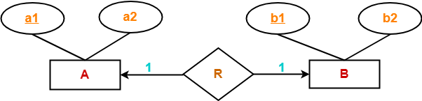
Case-04: For Binary Relationship With Cardinality Ratio 1:1
Emp
Dept
manages
Here, two tables will be required. Either combine ‘R’ with ‘A’ or ‘B’
Way-01:
AR ( a1 , a2 , b1 )
B ( b1 , b2 )
Way-02:
A ( a1 , a2 )
BR ( a1 , b1 , b2 )
Way-03:
A( a1 , a2 )
B ( b1 , b2 )
R (a1, b1) primary key(a1 or b1)
If relationship attribute(start_date)
Shift towards total side side

Slide 66
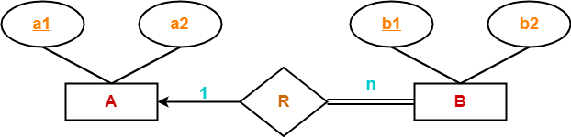
Rule-06: For Binary Relationship With Both Cardinality Constraints and Participation Constraints-
Cardinality constraints will be implemented as discussed in Rule-05.
Because of the total participation constraint, foreign key acquires NOT NULL constraint i.e. now foreign key can not be null.
Case-01: For Binary Relationship With Cardinality Constraint and Total Participation Constraint From One Side-
Because cardinality ratio = 1 : n , so we will combine the entity set B and relationship set R.
Then, two tables will be required-
A ( a1 , a2 )
BR ( a1 , b1 , b2 )
Because of total participation, foreign key a1 has acquired NOT NULL constraint, so it can’t be null now.

Slide 67
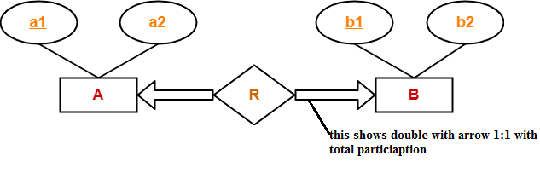
Case-02: For Binary Relationship With Cardinality Constraint and Total Participation Constraint From Both Sides-
If there is a key constraint from both the sides of an entity set with total participation, then that binary relationship is represented using only single table.
Here, Only one table is required.
ARB ( a1 , a2 , b1 , b2 )
If relationship attribute will be there in ARB

Slide 68
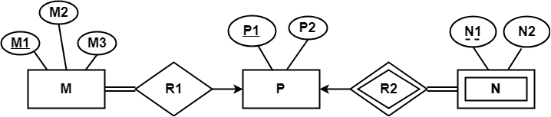
Exercise
Problem-01:
Find the minimum number of tables required for the following ER diagram in relational model-
Applying the rules, minimum 3 tables will be required-
MR1 (M1 , M2 , M3 , P1)
P (P1 , P2)
NR2 (P1 , N1 , N2)

Slide 69
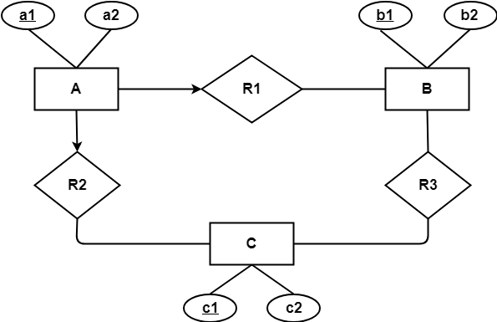
Problem-02:
Find the minimum number of tables required to represent the given ER diagram in relational model-
R3 M:N
Applying the rules, minimum 4 tables will be required-
AR1R2 (a1 , a2 , b1 , c1)
B (b1 , b2)
C (c1 , c2)
R3 (b1 , c1)
Consider the A as employee, B as Department, C as project, Many employee working in one department and many employee working on one project

Slide 70
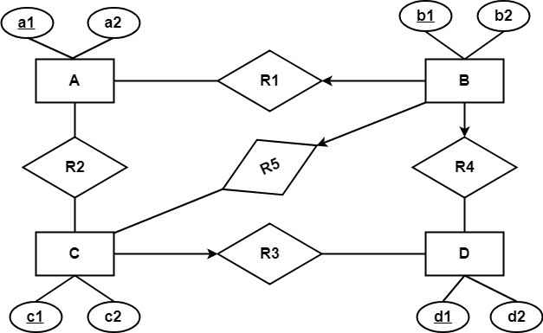
Problem-03:
Find the minimum number of tables required to represent the given ER diagram in relational model-
Applying the rules, minimum 5 tables will be required-
BR1R4R5 (b1 , b2 , a1 , c1 , d1)
A (a1 , a2)
R2 (a1 , c1) M:N
CR3 (c1 , c2 , d1)
D (d1 , d2)

Slide 71
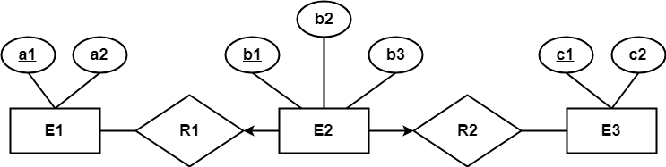
Problem-04:
Find the minimum number of tables required to represent the given ER diagram in relational model-
Applying the rules, minimum 3 tables will be required-
E1 (a1 , a2)
E2R1R2 (b1 , b2 , a1 , c1 , b3)
E3 (c1 , c2)

Slide 72

Problem-05:
Find the minimum number of tables required to represent the given ER diagram in relational model-
Applying the rules that we have learnt, minimum 6 tables will be required-
Account (Ac_no , Balance , b_name)
Branch (b_name , b_city , Assets)
Loan (L_no , Amt , b_name)
Borrower (C_name , L_no) M:N
Customer (C_name , C_street , C_city)
Depositor (C_name , Ac_no) M:N

Slide 73

Problem 6

Slide 74
Summery of Symbols used in E-R diagram
Customer
Name
Hold
Entity
Attribute
Relationship
EmpID
Age
PhoneNo
Primary Key
Attribute
Derived
Attribute
Multi Valued Attribute
Payment
PymtID
Issue
Weak Entity
Discriminating
Attribute
Weak Entity
Relationship
Role
Name
E
R
E
R
ISA
Total
Participation
Role
Indicator
Specialization/
Generalization

